Slide 1

NESTED SQL SUBQUERIES
Presented by: Taiwo Fasanya

Slide 2


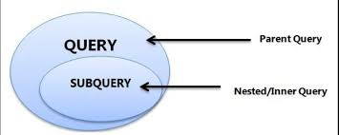
WHAT IS A SUBQUERY?
In simplest terms, a subquery is a query in another query. Subqueries are also known as inner queries or sub selects. They are used to retrieve data or perform calculations from multiple tables in a single query.

Slide 3
Types of subqueries
Single Row Subqueries: Returns zero or one row
Multiple Row Subquery: Returns one or more rows
Multiple Column Subqueries: Returns one or more columns

Slide 4
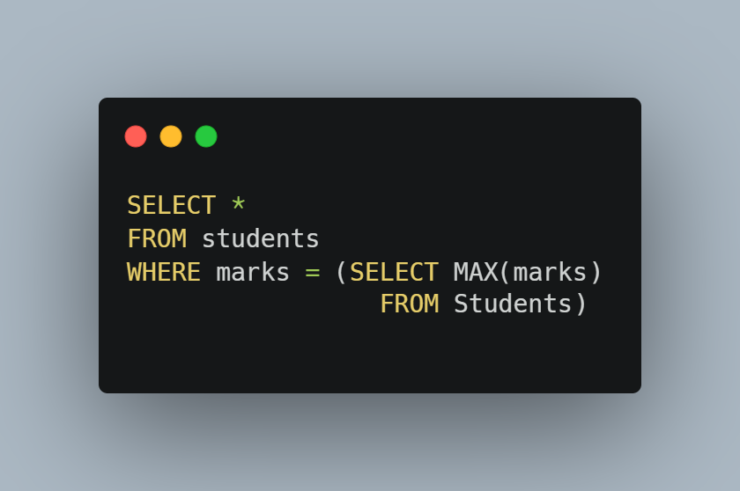
APPLICATIONS of subqueries

Slide 5
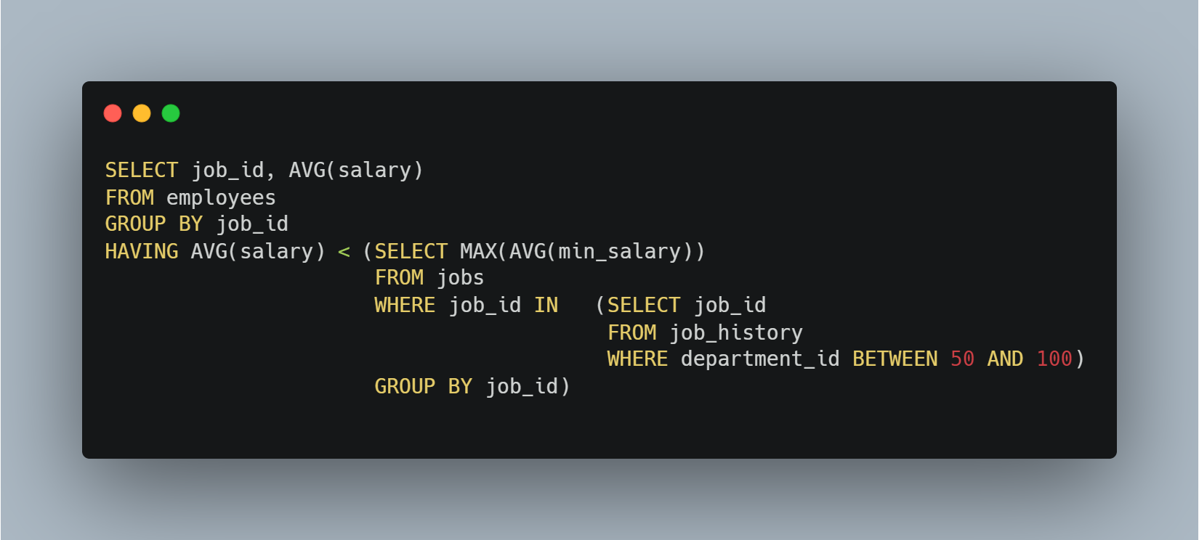
APPLICATIONS of subqueries

Slide 6
THANK YOU FOR LISTENING…

